Slide 1
The Biblical Chronology of the End-Time events with special reference to the
post -rapture scenario

Slide 2
Biblical chronology is essential for the Second Advent believers to understand the Rapture clock.
God’s “scheme of doing things” in this world to send His Son in His people, enables us to experience the real “ease of doing things” in taking off to the mid-skies in His coming.
Right from first Adam till the last Adam. God maintaining the chronicles of all the generations of His chosen people.

Slide 3
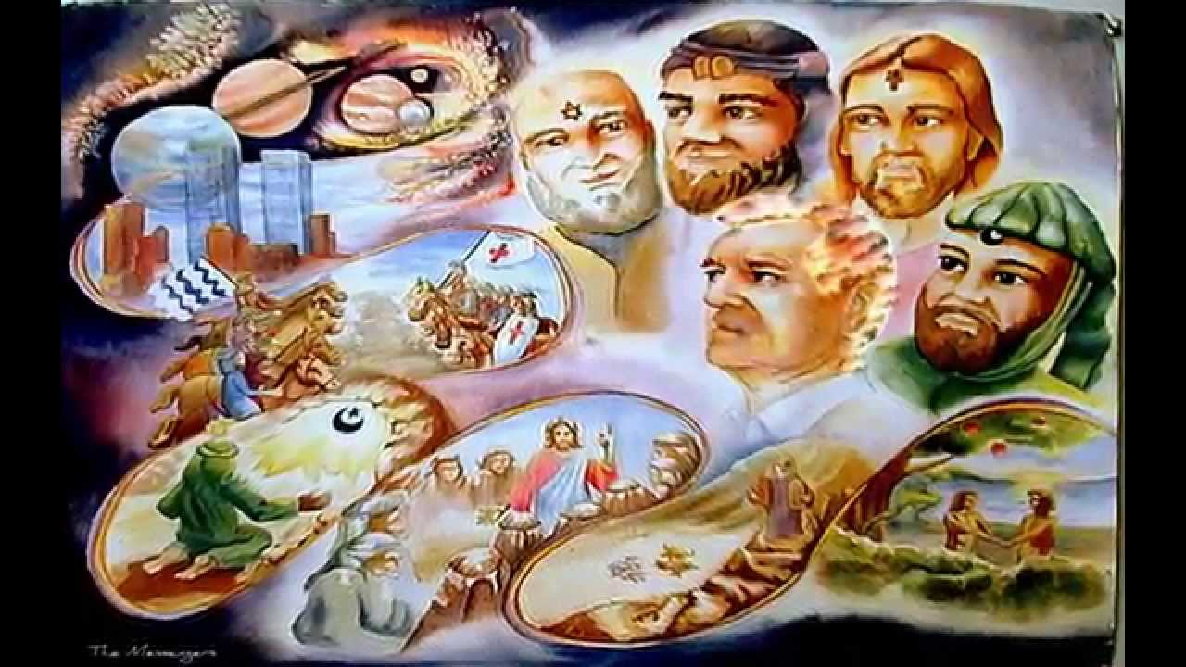
Adam, Abraham, Moses, David, Joseph, Zerubbabel, Joseph are some of the important forefathers in the clan of Jesus

Slide 4

Biblical Chronology of Events leading to the Rapture and the post-rapture events about to take place in the Biblical calendar
The rise of Apostasy
The secret entry of false men
Falling away from the faith (2 Thess 2:3)

Slide 5

The secret anointing of the Holy Spirit on the Rapture believers

Slide 6
The mystery of lawlessness (iniquity) being at work (2 Thess 2:7)
The sudden snatching away of believers to the mid skies: “Rapture”
Post Rapture events and coming of Lord Jesus

Slide 7
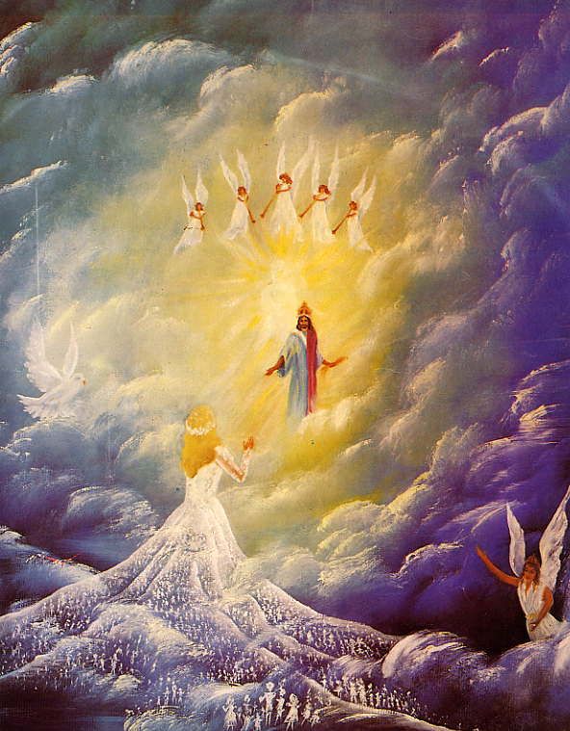
The Bridegroom taking away the living believers with Rapture faith for the 7 years wedding feast in New Jerusalem

Slide 8
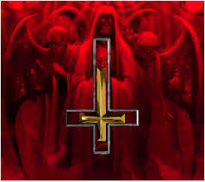
The beginning of Seven years of Tribulations on earth and the Emergence of AntiChrist

Slide 9
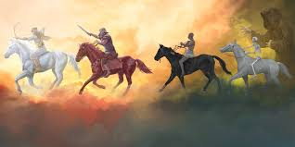
The coming of Lord Jesus on four different horses, to save, gather and protect the tribulation believers who turn to Him Rev (6: 1-8)

Slide 10
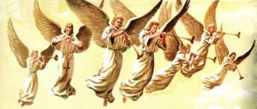
The tribulations of seven trumpets

Slide 11

The breaking off of treaty of AntiChrist with Jews after 3 ½ years of his reign

Slide 12
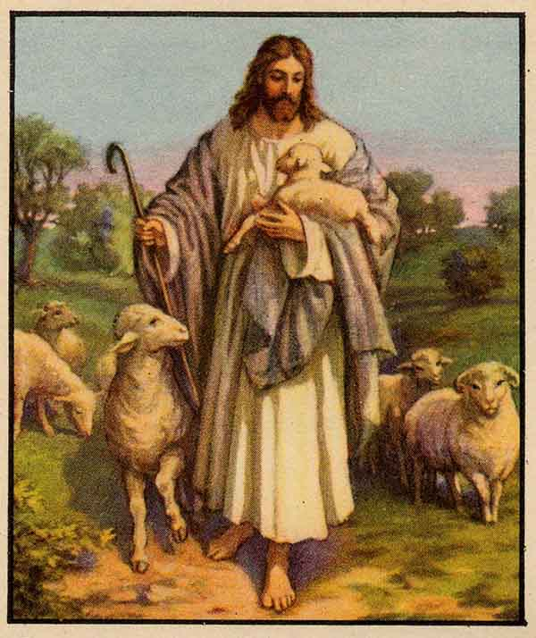
The setting up of abomination of desolation that marks the beginning of Second 3 ½ years of Antichrist rule. Matt 24:15
Jesus, as the Lamb opening the seven seals of the Book that was written within and on the backside

Slide 13

Intensified rule of antichrist and strict implementation of 666

Slide 14
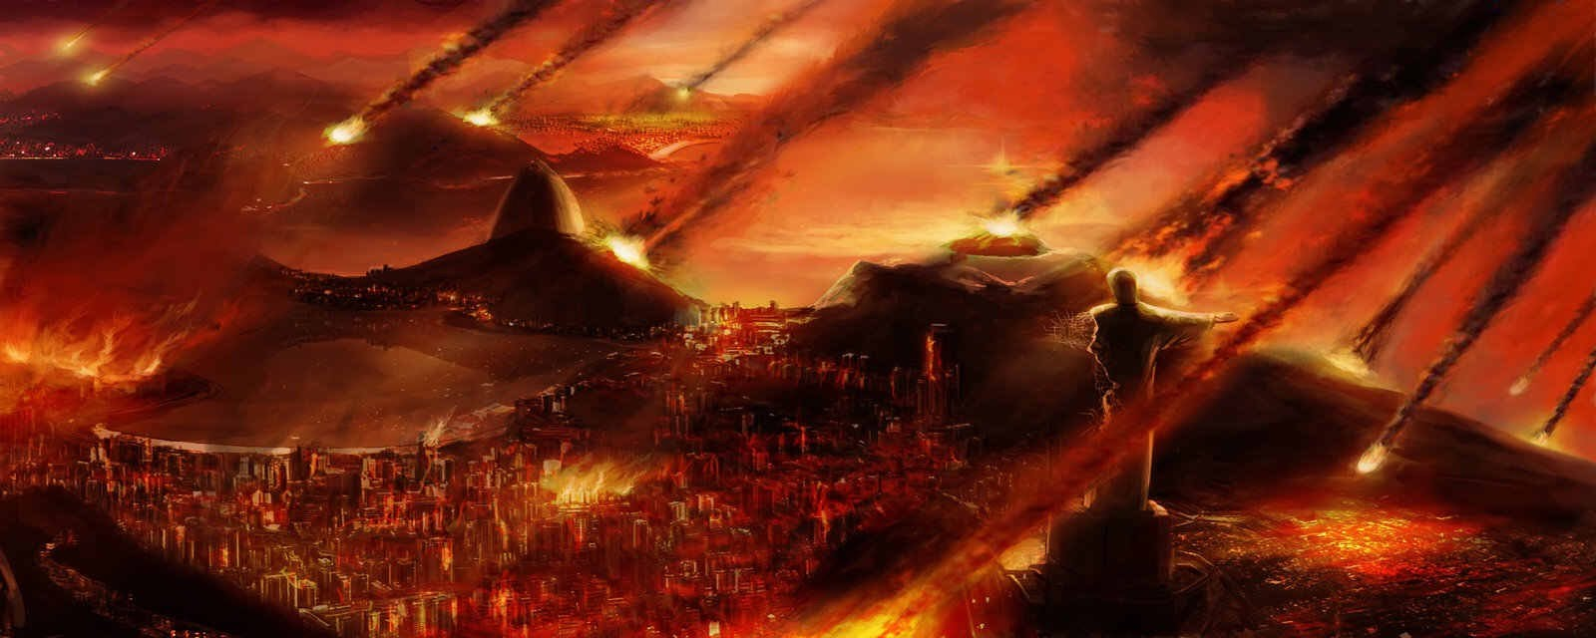
Antichrist slaying the holymen (Rev 13:7) and killing the two witnesses (Moses & Elijah)
The resurrection and ascension of the two witnesses (Rev 11:3)
The end of seven years of tribulation

Slide 15
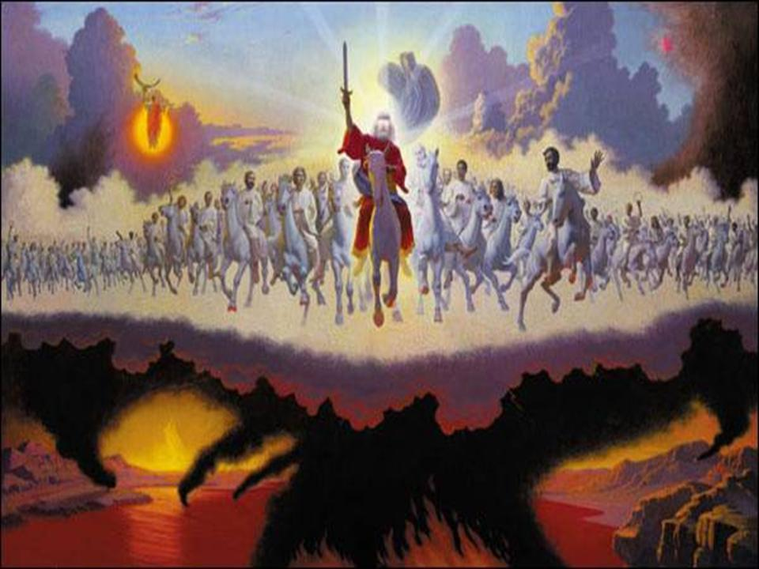
The war at Armageddon: Christ destroys antichrist and false prophet and throws them in lake of fire.

Slide 16
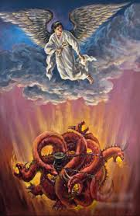
Satan bound in Abyss for a thousand years

Slide 17
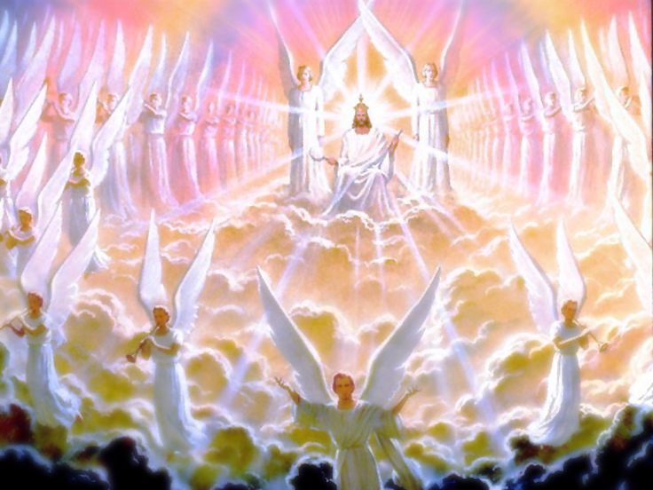
The Second coming of Lord Jesus Christ to this world; setting His throne in Jerusalem

Slide 18
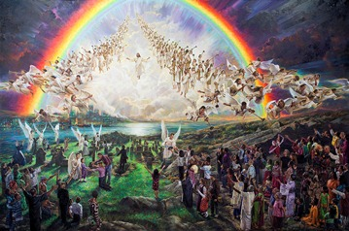
The millennium i.e. the 1000 years rule of Christ on earth
The period of full gospel proclamation
End of the millennium

Slide 19
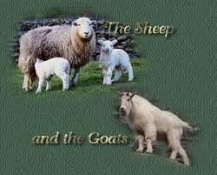
Christ judging the living (separating the sheep from the goats)

Slide 20
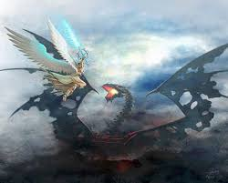
The release of Satan from the Abyss

Slide 21

The war of Gog and Magog

Slide 22
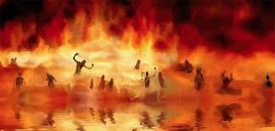
Satan and his followers thrown into hell

Slide 23
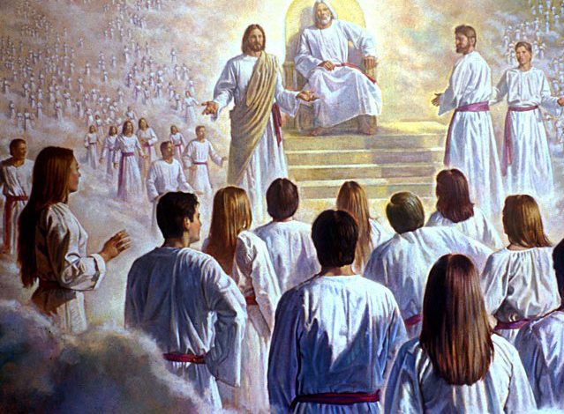
Preparation for the great white throne judgement
The unfolding of the books and other books

Slide 24
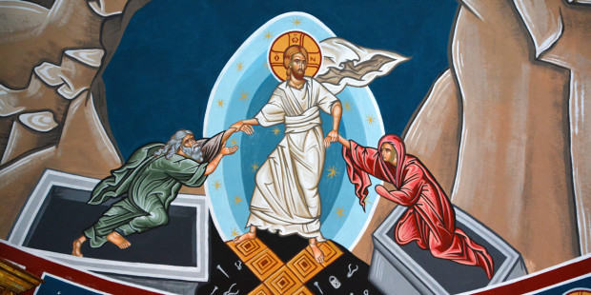
The resurrection of all the dead

Slide 25
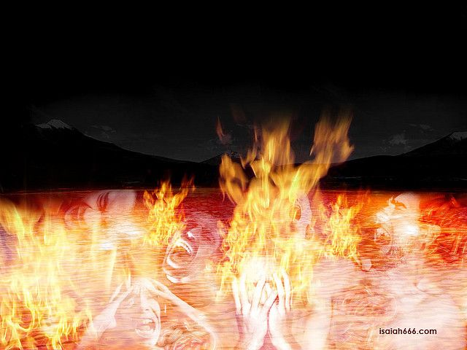
Death and Hades thrown into the burning fire

Slide 26
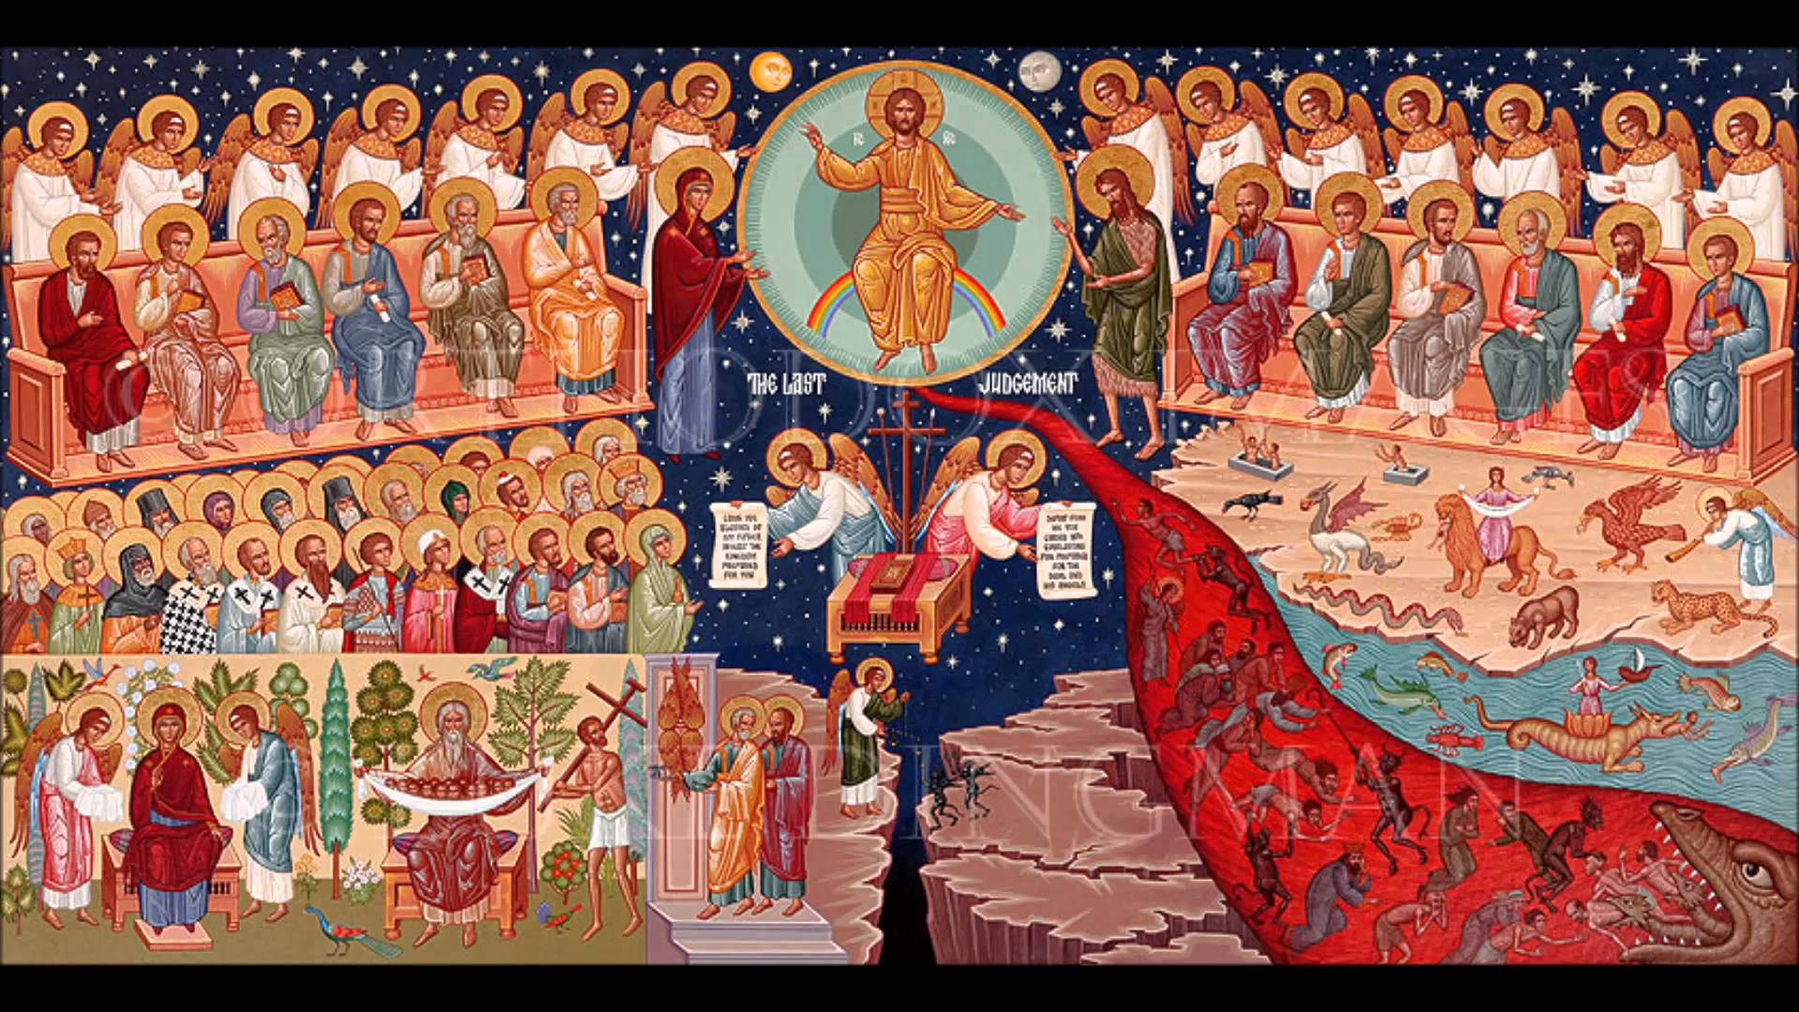
The final judgement

Slide 27
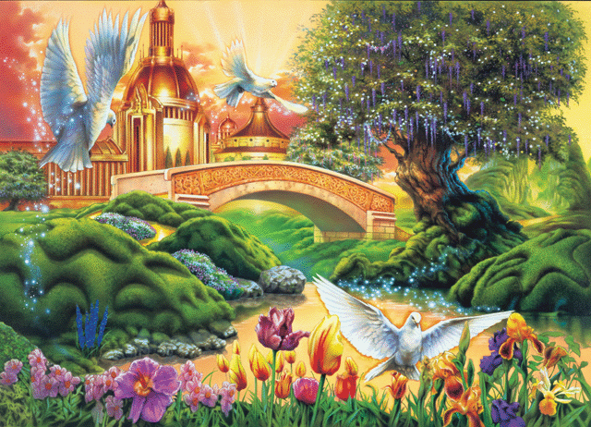
The new heaven and new earth

Slide 28

The final three fold yielding of the crop
100 folds –New Jerusalem
60 folds – Heaven for the saved
30 folds - The earthly heaven

Slide 29

Lord Jesus being present in all three places and with all who were in Him & with Him

Slide 30

The end of God’s great plan of Salvation
Maranatha. Amen. Come, Lord Jesus, Amen.

